Slide 1
Pneumonia
MOSES WAKULOBA, EH, MSC HA

Slide 2
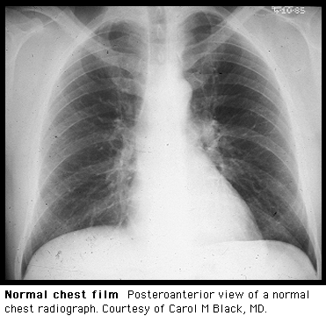
Normal Chest X-Ray
Courtesy of Up To Date

Slide 3
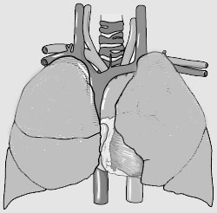
Review of Lung Anatomy
RUL
LUL
RML
LLL
RLL
Lingula
http://www.meddean.luc.edulumenMedEdGrossAnatomythorax0thor_lecthorax1.jpg

Slide 4
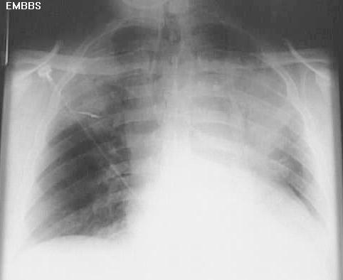
What is pneumonia?
Infection of the lung parenchyma
Causative agents include bacteria, viruses, fungi
www.netmedicine.com/xray/xr.htm

Slide 5
How do we classify pneumonia?
Community Acquired Pneumonia (CAP)
Nosocomial/Hospital Acquired Pneumonia
Others, such as PCP, BOOP

Slide 6
CAP
CAP = pneumonia in person not hospitalized or residing in a long-term care facility for ≥ 14 days
Clinical Infectious Diseases 2000;31:347-82

Slide 7
CAP - Why do we care about it?
5.6 million cases annually
1.1 million require hospitalization
Mortality rate =12% in-hospital; near 40% in ICU patients
Am J Respir Crit Care Med 163:1730-54, 2001

Slide 8
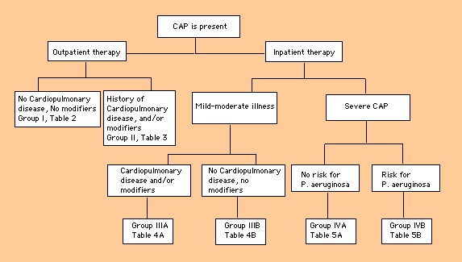
CAP – Patient Stratification
Am J Respir Crit Care Med 163:1730-54, 2001

Slide 9
CAP – Testing
CXR
Sputum Gram Stain and culture
Pulse oximetry
Routine lab testing – CBC, BMP, LFTs
ABG
Thoracentesis if pleural effusion present
Am J Respir Crit Care Med 163:1730-54, 2001

Slide 10
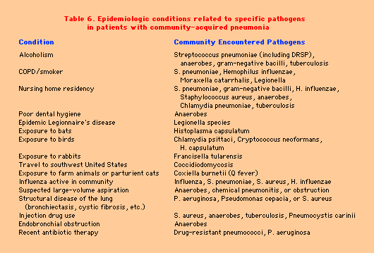
CAP – Modifying Factors
Am J Respir Crit Care Med 163:1730-54, 2001

Slide 11
CAP – Modifying Factors
MODIFYING FACTORS THAT INCREASE THE RISK OF
INFECTION WITH SPECIFIC PATHOGENS
Penicillin-resistant and drug-resistant pneumococci
Age > 65 yr
B-Lactam therapy within the past 3 mo
Alcoholism
Immune-suppressive illness (including therapy w/ corticosteroids)
Multiple medical comorbidities
Exposure to a child in a day care center
Enteric gram-negatives
Residence in a nursing home
Underlying cardiopulmonary disease
Multiple medical comorbidities
Recent antibiotic therapy
Pseudomonas aeruginosa
Structural lung disease (bronchiectasis)
Corticosteroid therapy (10 mg of prednisone per day)
Broad-spectrum antibiotic therapy for > 7 d in the past month
Malnutrition
Am J Respir Crit Care Med 163:1730-54, 2001

Slide 12
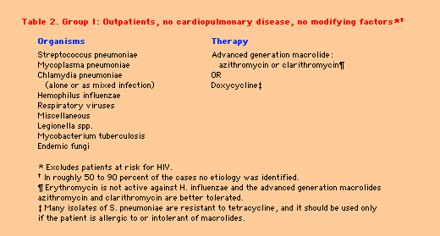
CAP – Algorithms
Am J Respir Crit Care Med 163:1730-54, 2001

Slide 13
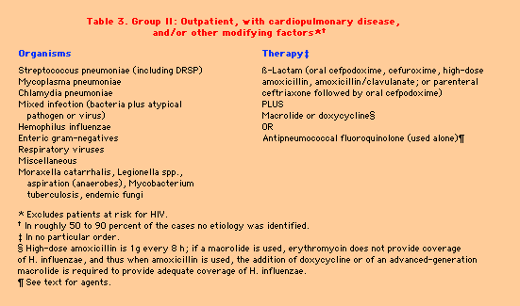
CAP – Algorithms
Am J Respir Crit Care Med 163:1730-54, 2001

Slide 14
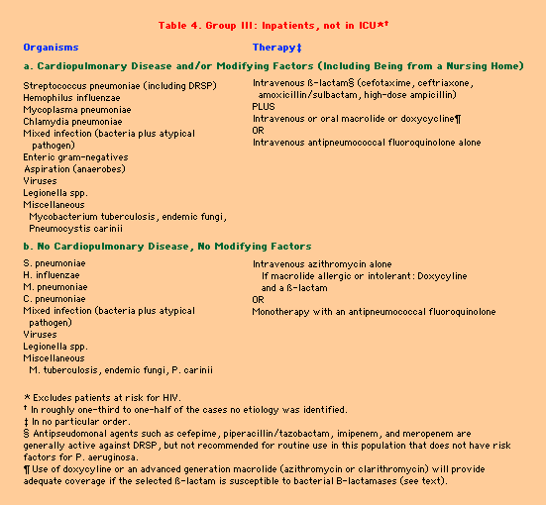

Slide 15
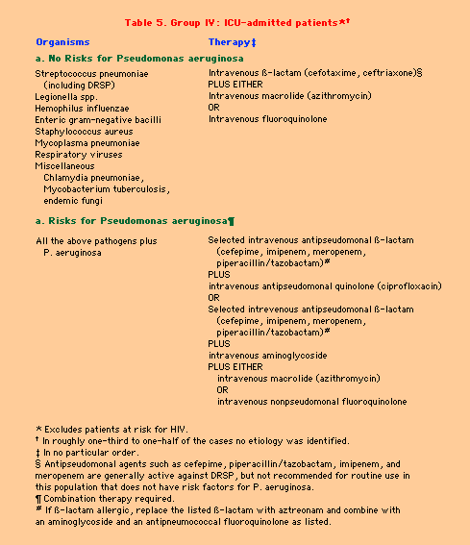

Slide 16
Duration of Therapy
? ? ? ? ? ?
5 -7 days - outpatients
7-10 days – inpatients, S. pneumoniae
10-14 days – Mycoplasma, Chlamydia, Legionella
14+ days - chronic steroid users
Am J Respir Crit Care Med 163:1730-54, 2001

Slide 17
CAP -The Switch to Oral Antibiotics
Switch if patient meets the following:
Inproved cough and dyspnea
Afebrile on 2 occasions 8 hours apart
If otherwise improving way waive this criteria
Decreasing WBC count
Functional GI tract with adequate PO intake
Am J Respir Crit Care Med 163:1730-54, 2001

Slide 18
CAP - Prevention
Influenza Vaccine
Pneumococcal Vaccine

Slide 19
Remember
Influenza Vaccine
Pneumococcal Vaccine
After discharge – Follow up CXR to exclude cancer
BEFORE DISCHARGE!!!!

Slide 20


Slide 21
HAP
Pneumonia occurring ≥48 h post admission
Excludes infection incubating at time of admission
Am J Respir Crit Care Med 153:1711-25, 1995

Slide 22
HAP - Epidemiology
5 to 10 cases per 1,000 hospital admissions
Incidence MUCH higher with mechanical ventilation (6-20 fold higher)
Second most common nosocomial infection but number one for M & M
Mortality near 70% in patients with HAP
Increased length of stay by 7-9 days
Am J Respir Crit Care Med 153:1711-25, 1995

Slide 23
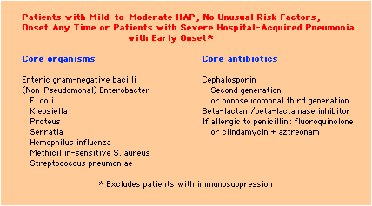
HAP – Stratification
Am J Respir Crit Care Med 153:1711-25, 1995

Slide 24
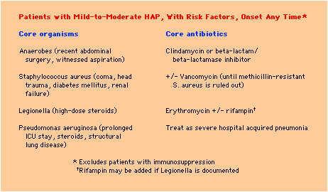
HAP – Stratification
Am J Respir Crit Care Med 153:1711-25, 1995

Slide 25
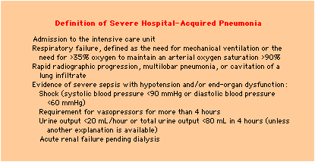
HAP – Stratification
Am J Respir Crit Care Med 153:1711-25, 1995

Slide 26
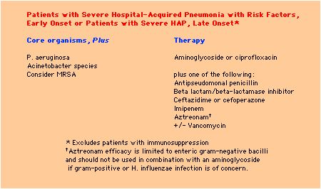
HAP – Stratification
Am J Respir Crit Care Med 153:1711-25, 1995

Slide 27
HAP – Failure of Therapy
Incorrect diagnosis – it is not pneumonia
Atelectasis, CHF, PE with infarction, lung contusion, chemical pneumonitis, ARDS, pulmonary hemorrhage
Pathogen resistance
Host factors that increase mortality
Age > 60, prior pneumonia, chronic lung disease
immunosuppression
Antibiotic resistance
Am J Respir Crit Care Med 153:1711-25, 1995

Slide 28
HAP - Prevention
Hand washing
Vaccination
Influenza
Pneumococcus
Isolation of patients with resistant respiratory tract infections
Enteral nutrition
Choice of GI prophylaxis
Subglottoc secretion removal?
Am J Respir Crit Care Med 153:1711-25, 1995

Slide 29
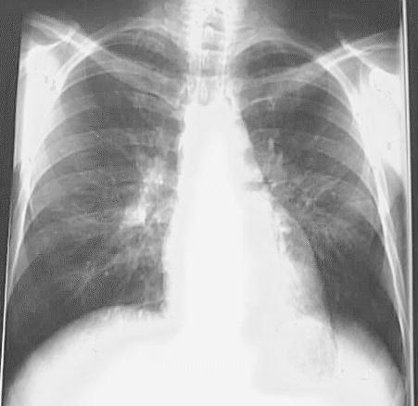
PCP
www.netmedicine.com/xray/xr.htm

Slide 30
Pneumocystis Carinii /Pneumocystis jiroveci¹ Pneumonia (PCP)
Uncommon until 1980’s with emergence of HIV disease
Caused by organism most closely related to fungi
Mode of transmission unclear, but felt to represent reactivation of latent infection
PCP reference = Harrison’s Principles of Internal Medicine
¹http://www.cdc.gov/ncidod/EID/vol8no9/02-0096.htm

Slide 31
PCP Pneumonia
Gradual onset of symptoms
Common symptoms include fever, cough, progressive dyspnea
Many patients asymptomatic
May present as a spontaneous pneumothorax

Slide 32
PCP – Lab Work
CD4 <200
LDH
Elevated in HIV+ persons w/ PCP
Very high values and increasing levels in face of therapy correlate w/ poorer prognosis
ABG
PaO2 <70 indication for steroids
Lung sampling
Definitive diagnosis dependent on isolation of Pneumocystis

Slide 33
PCP - Treatment
TMP/SMX (trimethoprim/sulfamethoxazole)
Drug of choice
High incidence of side effects in HIV+ pts
Dapsone + TMP
Clindamycin + primaquine
Atovaquone
Pentamadine IV

Slide 34
PCP - Prophylaxis
TMP/SMX* – DS 3x/wk or SS qd
Dapsone +/- pyrimethamine*
Aerosolozed pentamadine
Atovaquone
*= also prophylaxis for Toxoplama

Slide 35
MKSAP Questions

Slide 36
A 72-year-old man is hospitalized because of fever, chills, and cough that have persisted for the past week. His medical history includes congestive heart failure, chronic bronchitis, and diabetes mellitus.
On physical examination, he is alert and in moderate respiratory distress. His temperature is 39 °C (102.2 °F), pulse rate is 120/min, respiration rate is 36/min, and blood pressure is 100/60 mm Hg. The physical examination reveals crackles in both lung fields at the bases. The jugular venous wave is noted 12 cm above the right atrium, and a soft S3 gallop is present on auscultation.
The leukocyte count is 21,000/μL, serum sodium is 124 meq/L, and serum creatinine is 2.4 mg/dL. Chest x-ray shows infiltrates in the right upper, left upper, and left lower lobes. Bronchiectactic changes are seen throughout the lower lung fields bilaterally. Measurement of arterial blood gases obtained on room air shows the following: pH, 7.38; Paco2, 32 mm Hg; and Pao2, 58 mm Hg.
Which one of the following antibiotic regimens is the most appropriate for this patient?
( A ) Doxycycline
( B ) Azithromycin
( C ) Ceftriaxone
( D ) Ciprofloxacin
( E ) Piperacillin-tazobactam and levofloxacin

Slide 37
Educational Objective
Select an appropriate empiric antibiotic regimen for a patient with severe community-acquired pneumonia with structural lung disease.
Critique (Correct Answer = E)
This patient has severe community-acquired pneumonia (pneumonia severity index class 5) complicated by evidence of bronchiectasis on chest radiograph. Risk factors responsible for this patient’s increased risk of mortality include his advanced age, the presence of significant comorbidities, unstable vital signs, significant hypoxia, hyponatremia, and acute renal failure. Although the actual pathogen is not identified in most cases of community-acquired pneumonia, the most common causes are Streptococcus pneumoniae, Legionella species, aerobic gram-negative bacilli, Haemophilus influenzae, Mycoplasma pneumoniae, and respiratory viruses. Pseudomonas aeruginosa is more common among patients with structural lung disease, such as bronchiectasis. Because this patient has life-threatening pneumonia, and especially because he has structural lung disease, coverage of P. aeruginosa is recommended. Piperacillin-tazobactam combined with levofloxacin would effectively provide double coverage for P. aeruginosa and would cover atypical pathogens. In clinical trials, doxycycline has been shown to be an effective regimen for patients with mild to moderate pneumonia, but concern about resistant pneumococcal species in severe cases and a lack of extended gram-negative spectrum would argue against its use here. Coverage of Legionella and Mycoplasma species should be a high priority; therefore, ceftriaxone alone is not a viable treatment option. Azithromycin covers S. Pneumoniae, H. Influenzae, and most atypicals, but lacks coverage against P. aeruginosa. Some strains of S. pneumoniae are resistant to ciprofloxacin; levofloxacin has enhanced coverage against S. pneumoniae and might be a more appropriate choice.

Slide 38
An 84-year-old man with chronic obstructive pulmonary disease is taken to the emergency department from his nursing home because of fever and increased shortness of breath. On physical examination, he is confused. His temperature is 39.4 °C (103 °F), pulse rate is 110/min, respiration rate is 32/min, and blood pressure is 110/60 mm Hg. His mucous membranes are dry, and his neck is supple. Lung examination reveals only distant breath sounds. The remainder of the examination is normal. The leukocyte count is 14,000/µL with a left shift. Oxygen saturation is 85% by pulse oximetry. Chest radiograph shows changes of emphysema and right lower lobe and right middle lobe infiltrates. The patient is unable to produce sputum.
Which of the following intravenous antibiotics is most appropriate?
( A ) Ceftriaxone
( B ) Ceftriaxone plus azithromycin
( C ) Ciprofloxacin
( D ) Azithromycin
( E ) Imipenem

Slide 39
Educational Objective
Manage a patient with pneumonia acquired in a nursing home who meets criteria for inpatient management.
Critique (Correct Answer = B)
This patient is best managed in the hospital because of risk of a poor outcome as defined by the Pneumonia PORT (Patient Outcomes Research Team) study. He has evidence of dehydration (dry mucous membranes), possibly indicating poor oral intake in addition to insensible fluid losses due to fever. He is therefore a candidate for parenteral treatment with fluid replacement as well as antibiotics. The principal pathogens causing community-acquired pneumonia are Streptococcus pneumoniae, Haemophilus influenzae, Moraxella catarrhalis, and atypical pathogens such as Legionella spp. A nursing-home patient also has an increased risk of gram-negative pathogens, such as Klebsiella pneumoniae. Ciprofloxacin has less activity than levofloxacin against S. pneumoniae, and there have been ciprofloxacin failures in patients with serious pneumococcal infections. Ceftriaxone alone covers H. influenzae, M. catarrhalis, and most strains of S. pneumoniae and K. pneumoniae but lacks activity against atypical pathogens. Azithromycin may also be effective coverage, as it is effective against atypical pathogens, some gram negative pathogens, and most strains of S. pneumoniae, but increasing resistance of S. pneumoniae to macrolides such as azithromycin may be of concern in a severely ill patient. Imipenem has broad-spectrum activity against all of the conventional bacterial pathogens, but lacks activity against atypical pathogens. A combination of ceftriaxone and azithromycin adequately covers all likely pathogens.

Slide 40
A 78-year-old man is evaluated because of a 4-day history of fever and cough productive of thick sputum. He has never smoked. Clarithromycin, given for the past 8 days, has been ineffective. A blood culture drawn in the office 2 days ago is reported to be growing gram-positive cocci in pairs, most likely S. pneumoniae. Chest radiograph shows an infiltrate in the right lower lobe. The patient is unable to produce sputum for examination.
Which of the following antibiotics, administered intravenously, is the most appropriate initial therapy?
( A ) Azithromycin
( B ) Levofloxicin
( C ) Ceftazidime
( D ) Trimethoprim-sulfamethoxazole

Slide 41
Educational Objective
Identify the most appropriate treatment for a patient with bacteremic pneumococcal pneumonia not responding to clarithromycin.
Critique (Correct Answer = B)
This patient with bacteremic pneumonia is not improving on therapy with clarithromycin, suggesting a clarithromycin-resistant isolate. Gram-positive cocci in pairs growing from the blood culture suggest pneumococci. Fluoroquinolones with increased activity against pneumococci, such as levofloxacin and sparfloxacin, would be beneficial for this patient.
Clarithromycin and other macrolides, such as erythromycin and azithromycin, bind to the bacterial ribosome and inhibit bacterial protein synthesis. Resistance to macrolides occurs by induction of a methylase enzyme that modifies the ribosome and thereby alters the drug target or by active specific efflux. The first mechanism affects clarithromycin, erythromycin, and azithromycin as well as the nonmacrolide, clindamycin, but the second mechanism affects only the macrolides. Since both resistance mechanisms affect all macrolides in clinical use in the United States, the choice of azithromycin would not be appropriate for a patient failing clarithromycin. Since there is epidemiologic linkage between resistance to macrolides and resistance to penicillin and to trimethoprim-sulfamethoxazole, trimethoprim-sulfamethoxazole would not be appropriate for this patient. Ceftazidime, in contrast to ceftriaxone and cefotaxime, has only limited activity against pneumococci and would therefore be a poor choice.

Slide 42
A 29-year-old woman with HIV infection and a CD4 cell count of 633/µL has had 3 days of fever, chills, productive cough, and chest pain. Physical examination shows signs of consolidation in the left lower lung fields. Her leukocyte count is 8600/µL, and chest radiograph shows a left lower lobe infiltrate.
Which of the following organisms is most likely present in her sputum?
( A ) Mycoplasma pneumoniae
( B ) Streptococcus pneumoniae
( C ) Legionella pneumophila
( D ) Pseudomonas aeruginosa
( E ) Pneumocystis carinii

Slide 43
Educational Objective
Identify the cause of community-acquired pneumonia in a patient with HIV infection and a high CD4 cell count.
Critique (Correct Answer = B)
The spectrum of opportunistic infections to which an HIV-infected person is susceptible is a function of host cellular and humoral immunocompetence. In patients with CD4 cell counts greater than 500/µL, conventional pathogens are more common than opportunistic pathogens. Community-acquired pneumonia with typical clinical features is most often caused by encapsulated bacteria, particularly Streptococcus pneumoniae and Haemophilus species. Risk factors for community-acquired pneumonia in patients with HIV infection include cigarette smoking and using injected drugs.
The typical presentation of bacterial pneumonia caused by encapsulated organisms is the abrupt onset of fever, chills, productive cough, and pleuritic chest pain. Patients with bacterial pneumonia have usually had symptoms for 3 to 5 days, in contrast to patients with Pneumocystis carinii pneumonia, whose symptoms have usually been present for several weeks. Focal pulmonary infiltrates and leukocytosis are the laboratory hallmarks of bacterial pneumonia in patients with or without HIV infection. Pneumocystis carnii pneumonia generally presents with diffuse interstitial infiltrates.
Mycoplasmal disease is unusual in patients with HIV infection and is unlikely to present with such an abrupt onset of respiratory symptoms or productive cough.
Legionella pneumophila is an unusual cause of pneumonia in patients with HIV infection but has been reported in association with nosocomial outbreaks.
Pseudomonas aerugihosa infections of the respiratory tract are more commonly seen in patients with more advanced HIV disease who have indwelling venous catheters or in patients who have been hospitalized. P. aerugihosa is a very unusual cause of community-acquired pneumonia in patients with CD4 cell counts greater than 500/µL.

